Slide 1











DATABASE PROJECT
MILITARY BASE
3 JUZ
NURDAULET DIDAR
KANAT NURADIL
ZHANUZAK RAIYMBEK

Slide 2
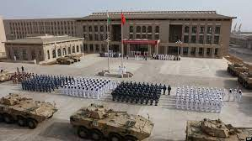
INTRODUCTION
The database project encompasses various entities representing a military organization, capturing essential information about soldiers, medics, missions, equipment, operations, exam results, divisions, security details, and vehicles. This comprehensive database aims to efficiently manage and organize data related to the personnel, resources, and activities within the military structure. Each entity plays a distinct role in capturing specific attributes, allowing for a holistic view of the organization's operations.

Slide 3
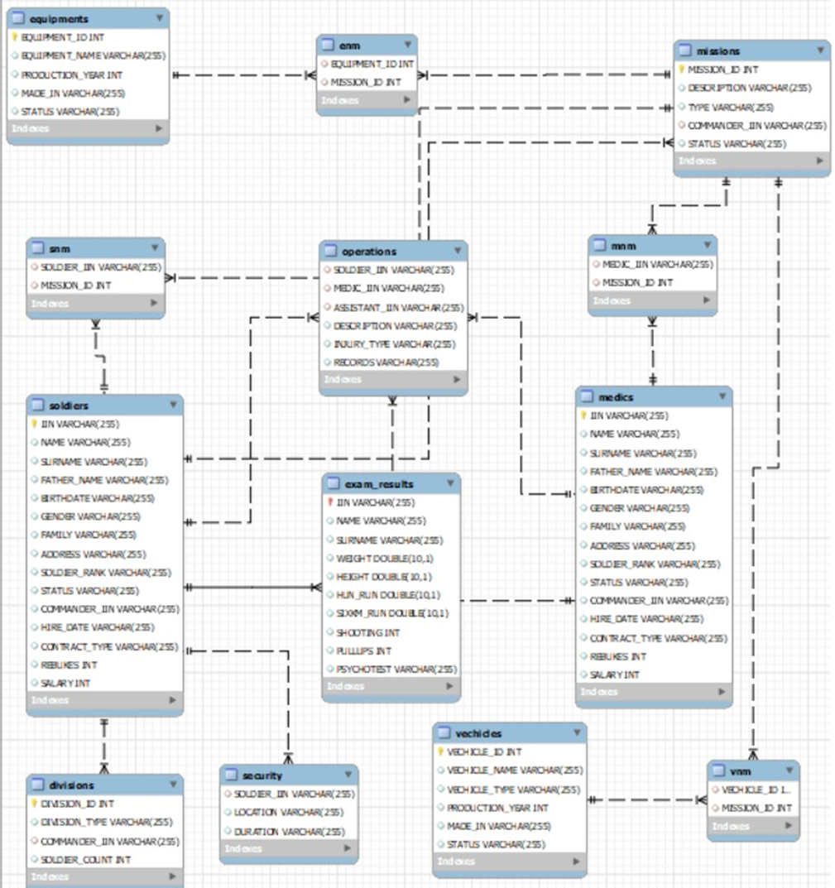
ERD
SOLDIERS - MISSIONS MANY TO MANY
SOLDIERS - SNM MANY TO ONE
SOLDIERS - EXAM_RESULTS ONE TO ONE
SOLDIERS - OPERATIONS ONE TO MANY
SOLDIERS TO SECURITY - ONE TO MANY
SOLDIERS TO DIVISIONS - MANY TO ONE
MEDICS TO MNM - MANY TO ONE
MEDICS TO OPERATIONS - ONE TO MANY(DOUBLE RELATION)
EQUIPMENTS TO ENM - MANY TO ONE
VEHICLES TO VNM - MANY TO ONE
AND ALL TABLES LIKE SNM, MNM TO MISSIONS - ONE TO ONE

Slide 4
Normalization
We normalized main tables to BCNF form. We don't have any columns with many values, each column identifies by IIN or ID and noting can be primary key instead of them, and nothing can identify primary key.

Slide 5
Total Queries: 30
SQL Basics: 5
Aggregations: 5
Indexes: 2
Triggers; 6
Subqueries: 6
Joins: 3
Window functions: 3

Slide 6
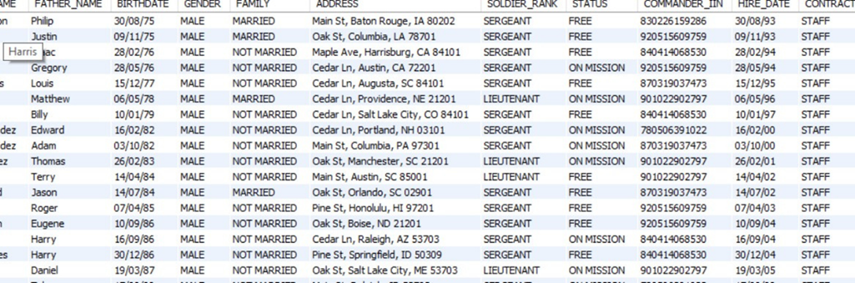
SQL BASICS
Retrieve all soldiers who have a rank more than private and work more than 5 years

Slide 7
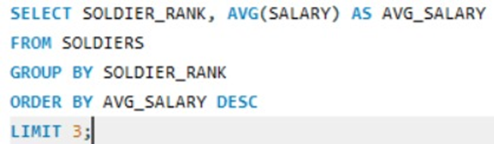
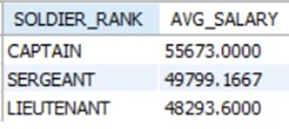
AGGREGATIONS
Top 3 soldier ranks with the highest average salary

Slide 8
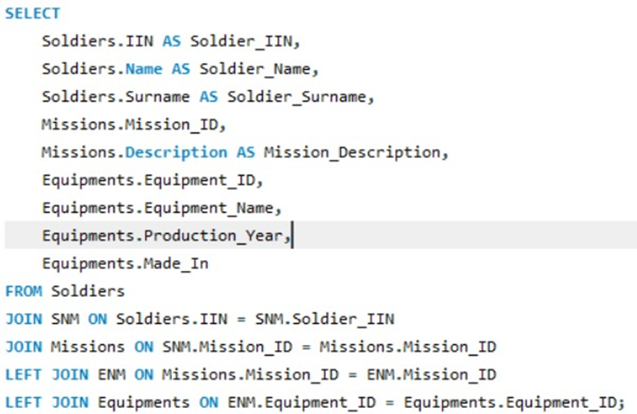
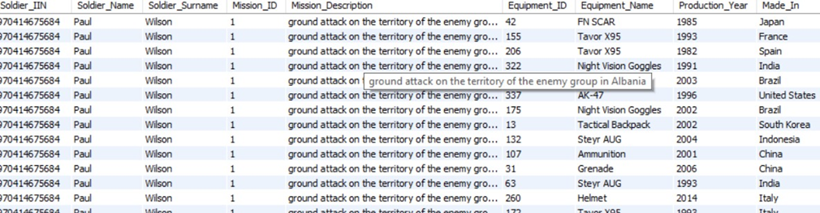
JOINS
Combine Soldiers and Equipments by Missions

Slide 9
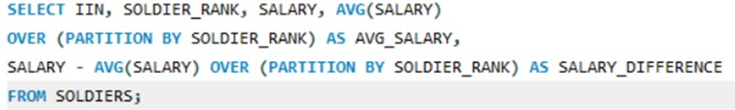
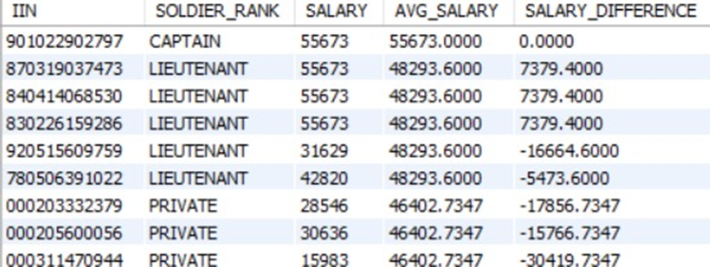
WINDOW FUNCTIONS
Calculate Average Salary Difference from Soldier's Rank Average

Slide 10
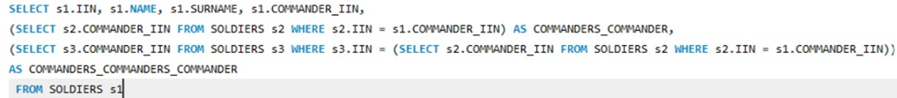
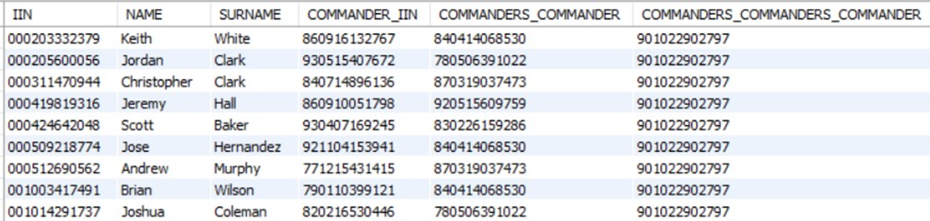
SUBQUERRY
RETRIEVE IERARHICAL RELATIONS OF EACH SOLDIER

Slide 11
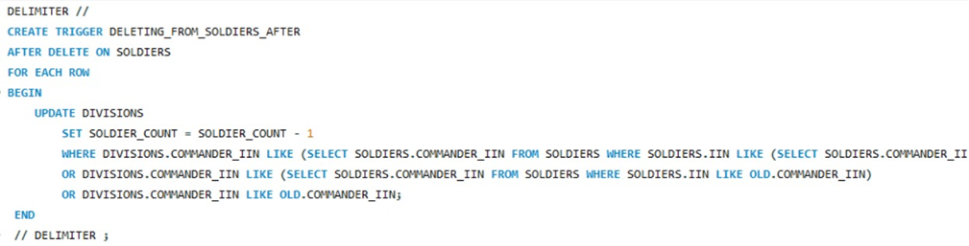
TRIGGER AND INDEXES

Slide 12
THANK YOU VERY MUCH!

